Slide 1
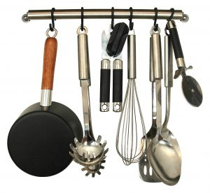
Kitchen Utensils and Gadgets
Always use the best
tool for the job!

Slide 2
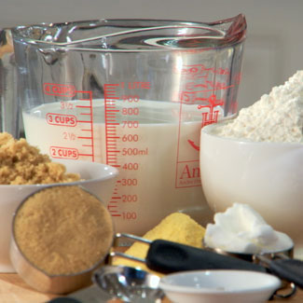
Measurement Utensils

Slide 3
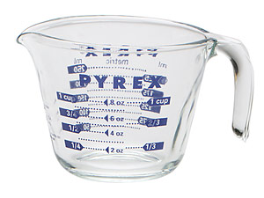
Liquid Measuring Cups
Used for measuring varying amounts of liquid ingredients. The extra space at the top is to prevent spills. The spout makes pouring easier. Available in:
-1 Cup Size
- 1 Pint Size (2 Cups)
-1 Quart Size (4 Cups)

Slide 4
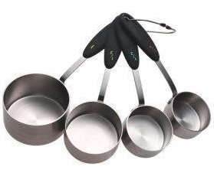
Dry Measuring Cups
Often come in a set of four (1/4 Cup, 1/3 Cup, ½ Cup, and 1 Cup)
Used to measure solid and dry ingredients.
They are filled to the top and leveled off evenly.

Slide 5
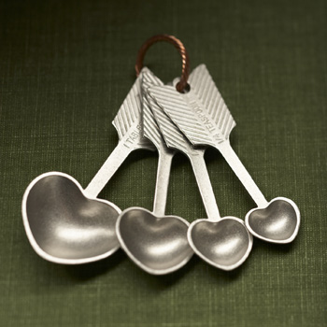
Measuring Spoons
Come in a set of four or more spoons which are used for measuring small amounts of dry, liquid, and solid ingredients.
Most common sizes are ¼ tsp., ½ tsp., 1 tsp., and 1 tbsp.

Slide 6
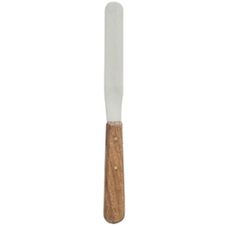
Straight Edge Spatula
Used to level-off dry ingredients in dry measuring cups and spoons

Slide 7
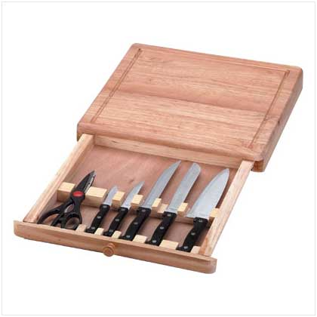
Cutting Utensils

Slide 8
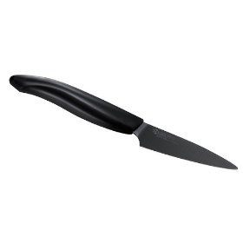
Paring Knife
Short-bladed knife
Used to pare and cut fruits and vegetables.
Also used to remove seeds.

Slide 9
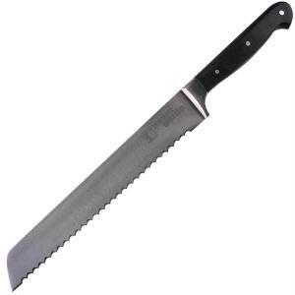
Bread Knife
Used for slicing bread.
Serrated edge helps cut without crushing.

Slide 10
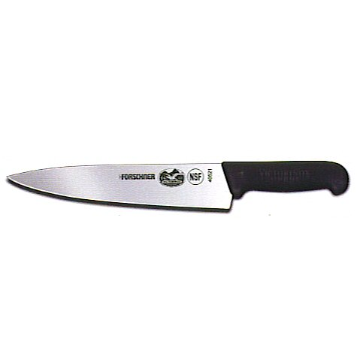
Chef’s Knife
Sometimes called a French knife
Used to slice, chop, and dice foods on a cutting board
Ex. – celery, carrots, peppers, etc.

Slide 11
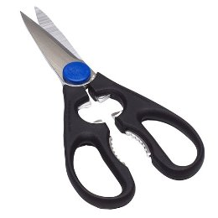
Kitchen Shears
Useful for cutting open plastic bags.
Used for snipping herbs and cutting soft foods

Slide 12
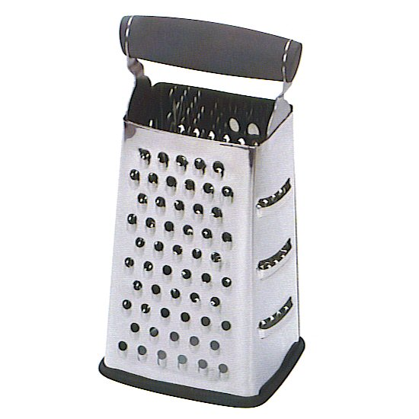
Grater
Used to shred or grate cheeses and vegetables

Slide 13
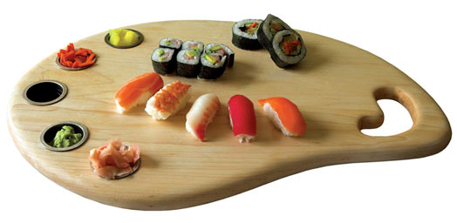
Cutting Board
Used when you cut foods with a knife. Protects the countertop and the knife’s edge.
Should be cleaned after every use

Slide 14
Mixing Utensils

Slide 15
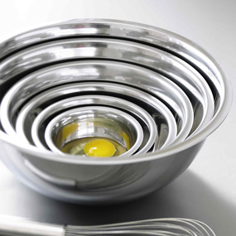
Mixing Bowls
Used to hold ingredients while mixing. May be made of glass, metal, or plastic and come in various sizes.

Slide 16
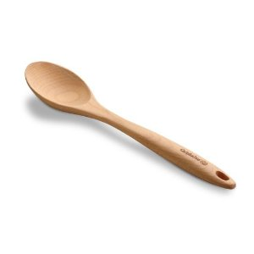
Large Spoon
Used to mix, baste, and stir foods when cooking. Spoons may be metal, plastic, or wooden.

Slide 17
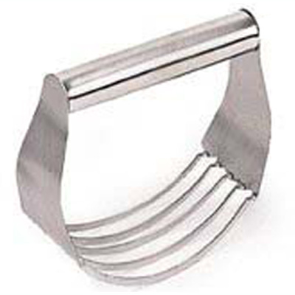
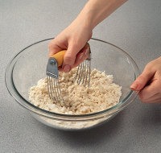
Pastry Blender
Used to cut shortening (fat) into flour

Slide 18
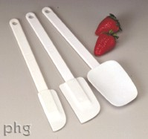
Rubber Spatula
Used for mixing and cleaning the sides of mixing bowls

Slide 19
Wire Whisk
Used to beat eggs, cream ingredients, etc.

Slide 20
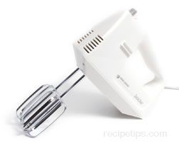
Electric Mixer
An electric small appliance that uses 2 beaters to mix ingredients together

Slide 21
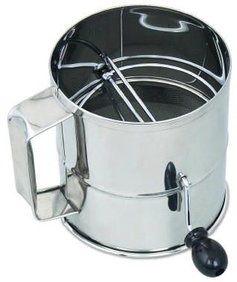
Sifter
Used to add air and remove lumps from dry ingredients

Slide 22
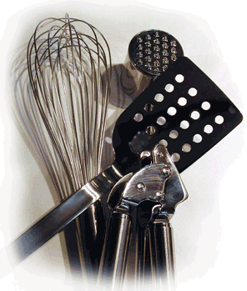
Cooking Utensils

Slide 23
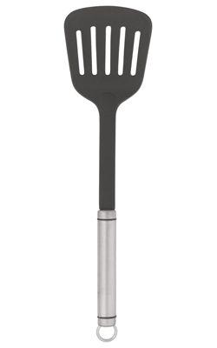
Turner
Used to flip foods like hamburgers, pancakes, and eggs while cooking

Slide 24
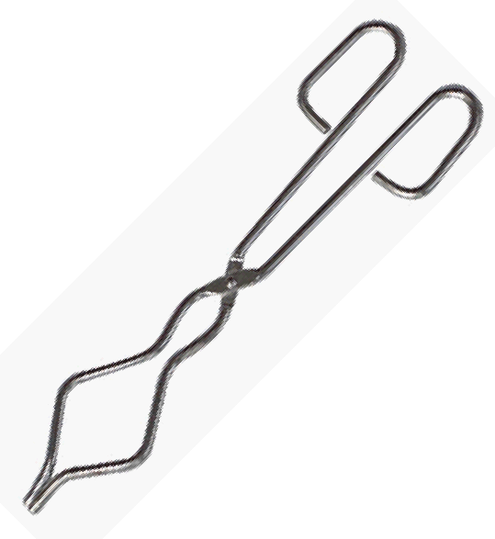
Tongs
Used to turn bacon, chops, steaks, and other foods while frying
Helpful for lifting foods, such as corn-on-the-cob, baked potatoes, etc.

Slide 25
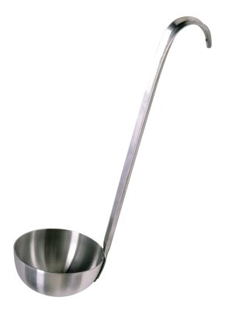
Ladle
Used to serve punches, soups, and stews

Slide 26
Cookware

Slide 27
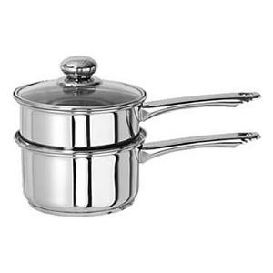
Double Boiler
Small pan that fits inside a larger pan
Food is cooked by the heat of the steam from the water in the larger pan

Slide 28
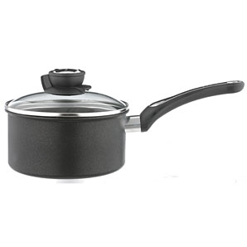
Saucepan
Used for many cooking chores so different sizes and tight-fitting lids are needed

Slide 29
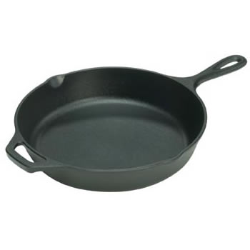
Skillet
Used for frying, pan-broiling and braising foods

Slide 30
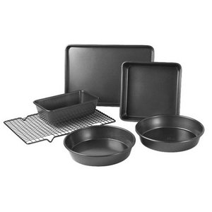
Bakeware

Slide 31
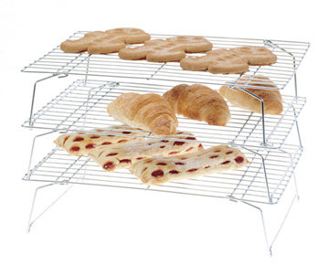
Cooling Rack
Wire rack that allows air to circulate around baked goods. Allows for cooling faster and more evenly

Slide 32
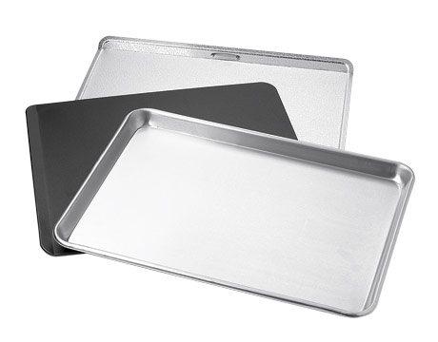
Cookie Sheet
Used to bake cookies and other baking items

Slide 33
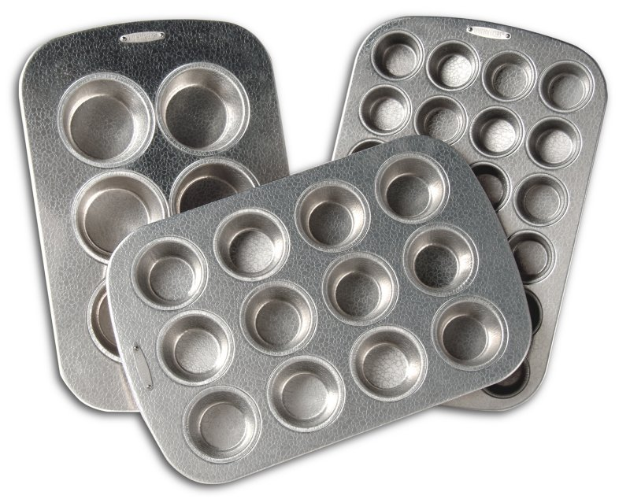
Muffin Pans
Used to bake muffins, cupcakes, etc.

Slide 34
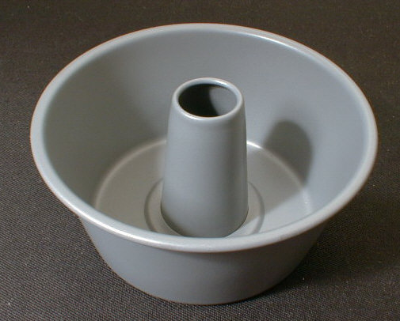
Tube Pans
Used to bake angel food, sponge, and chiffon cakes

Slide 35
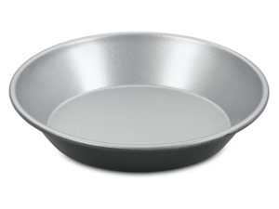
Pie Pan
Used to bake pies and other items

Slide 36
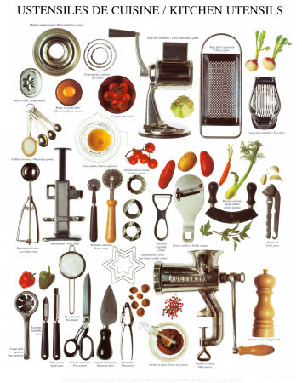
Other Kitchen Utensils

Slide 37
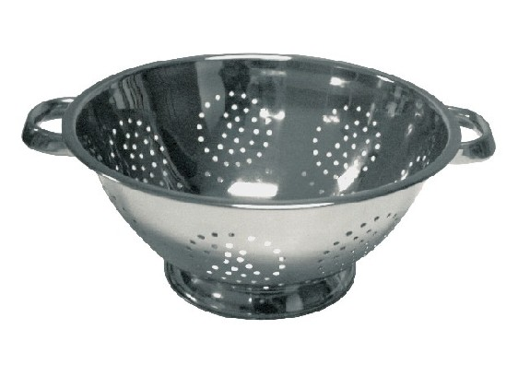
Colander
Helpful for rinsing fruits and vegetables, as well as, draining cooked foods like pasta.

Slide 38
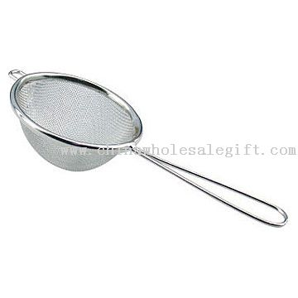
Strainer
Used to separate solids from liquids

Slide 39
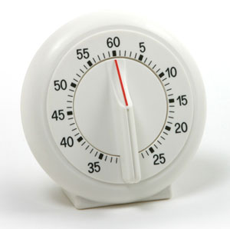
Timer
Used to measure cooking and baking time. Helps keep foods from overcooking

Slide 40
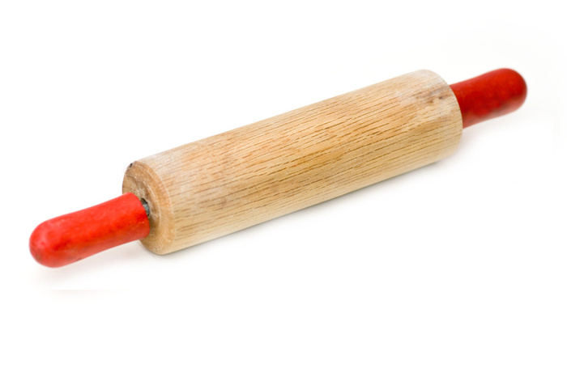
Rolling Pin
Used to flatten dough into a thin, even layer

Slide 41
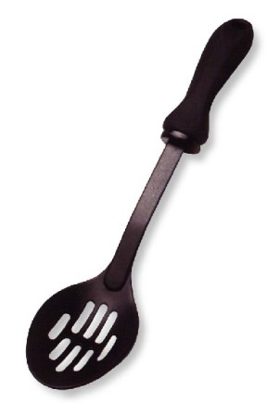
Slotted Spoon
Used to remove foods from cooking liquids

Slide 42
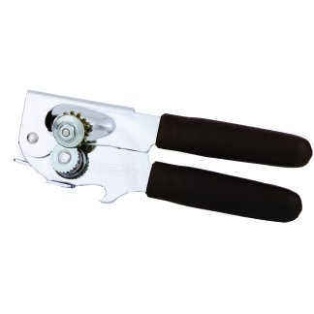
Can Opener
Used to open canned foods

